Slide 1
information security
Sensitive Data Exposure
Group member name and their id:
Syed Rayyan Saeed 240558
Shiraz khan 240550
Abdullah shaifal 243438
Instructor: Ma’am Nimra Shafqat

Slide 2
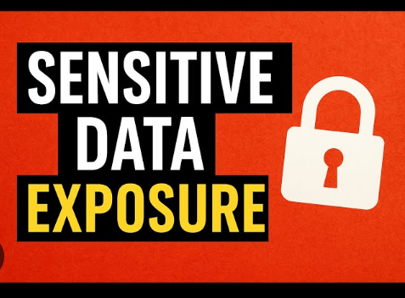
What is Sensitive Data Exposure?
Sensitive Data Exposure refers to a security weakness where confidential information such as usernames, passwords, credit card numbers, medical data, or personal records becomes accessible to unauthorized people.
Why is it Important in Security?
Personal and financial information can be misused.
It leads to identity theft and account takeovers.
It damages trust and reputation of organizations.
It is one of the OWASP Top 10 most dangerous security risks.

Slide 3
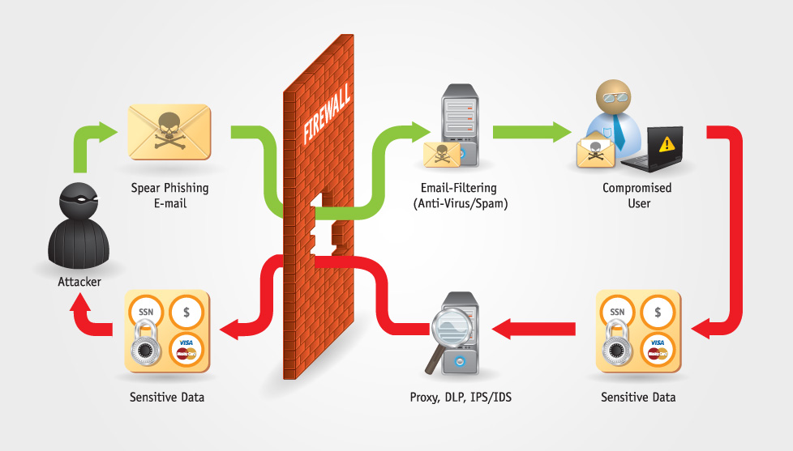

Slide 4
🔐 Sensitive Data Exposure – Full Process Explanation
1.Attacker Initiates the Attack
An attacker creates a spear-phishing email.
The email is crafted to look legitimate and targets a specific user.
Purpose: trick the user into clicking a malicious link or opening an attachment.
2.Email Enters the Organization
The phishing email passes through the firewall.
It then goes through email filtering systems (anti-virus / anti-spam).
Due to:
  Zero-day malware
  Poor filtering rules
  Human-focused social engineering
  the email is not detected.
3.User Is Compromised
The user opens the email and interacts with it.
This results in:
  Malware installation, or
  Credential theft
The attacker now has unauthorized access using the user’s system or account.

Slide 5
4️.Internal Access to Sensitive Data
Using the compromised user’s access, the attacker reaches internal systems.
Sensitive data includes:
  SSN
  Credit card details
  Bank and financial data
This data may be:
  Stored unencrypted
  Improperly protected
  Accessible due to excessive permissions
5️.Attempted Security Monitoring
Tools such as:
  Proxy
  DLP (Data Loss Prevention)
  IDS/IPS
  inspect outgoing traffic.
However, the attacker:
  Encrypts the traffic
  Hides it in normal network activity
  Exploits misconfigured controls

Slide 6
6️. Data Exfiltration
Sensitive data is transferred outside the organization.
The firewall allows the traffic because it appears legitimate.
Security tools fail to block it.
7.Sensitive Data Exposure Occurs
The attacker successfully receives the stolen data.
Confidential information is now:
  Exposed
  Misused
  Sold or exploited

Slide 7
🌍 Real-World Examples of Sensitive Data Exposure
1️.Credit Card Data Breach (Retail Store)
Hackers send phishing emails to store employees.
An employee clicks the email.
Hackers access the payment system.
Credit card numbers of customers are stolen.
➡️ Exposed data: Card numbers, CVV, names
2️.Hospital Data Leak
A hospital stores patient records without proper encryption.
An attacker gains access to the system.
Medical records are downloaded.
➡️ Exposed data: Patient history, reports, IDs
➡️ Impact: Privacy violation (HIPAA)

Slide 8

How the Attack Happens (Flow / Steps)
How the Attack Happens (Attacker sends a fake email
  It looks real, so the user trusts it.
Email is not blocked
  Security tools do not catch the email.
User clicks the email
  The user clicks a link or opens a file.
  The attacker gets access to the user’s computer.
Sensitive data is accessed
  The attacker finds important data like:
    passwords
    credit card numbers
    personal details
Data is sent to the attacker
  The stolen data is sent outside the company.
Sensitive data is exposed
  The attacker now has the private data.

Slide 9
Impacts:
1. Account Compromise:
Hackers log into user accounts and steal information.
2. Financial Loss:
Credit card or banking data can be used for fraud.
3. Identity Theft:
Attackers use personal documents to impersonate victims.
4. Loss of Privacy:
Medical records, address, and personal information become public.
5. Brand Damage:
Organizations lose customer trust and face negative publicity.

Slide 10
Prevention:
How to protect data:
Always use encryption (AES, hashing + salt for passwords)
Never store plain text passwords
Use HTTPS for secure communication
Secure backups and cloud storage
Use strong access control & permissions
Regular vulnerability scanning
Do not hardcode API keys or passwords in code

Slide 11
Summary:
Sensitive Data Exposure happens when confidential data is not protected.
Causes include plain text storage, weak encryption, or misconfigured servers.
Attackers use exposed data to hack accounts and steal money. Encrypting data and good security practices can prevent this issue.

Slide 12
References:
https://www.ssllabs.com/ssltest/

Slide 13

Any question

